Slide 1
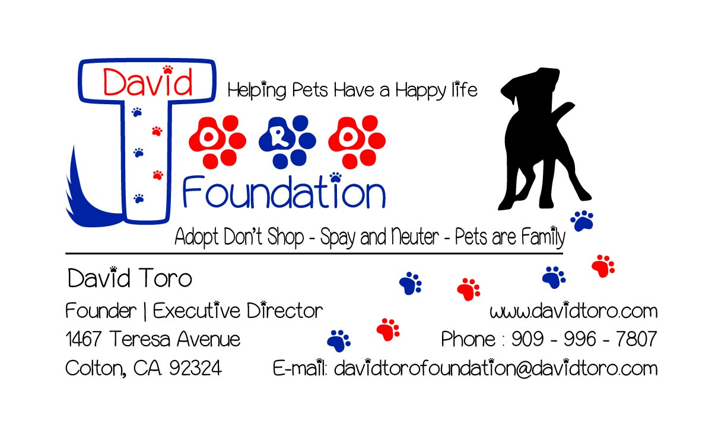

Slide 2
David Toro Foundation
Mission Statement.
Training - Outreach - Rescue - Opportunity
Training for Responsible pet owners and pets to have a harmonious environment in the home.
Outreach to communities with education on responsible pet ownership. Factual information on pet population, euthanasia, benefits to spay and neuter, microchips and licensing.
Rescue animals that are strays, have been abandoned, abused, unable to be cared for, in need of medical attention, and animals that are in shelters, by finding suitable homes. Partnering with Rescues and Fosters.
Opportunity to reduce the amount of unwanted pets going to the shelter and being euthanized, and to educate the community on responsible pet ownership, by providing Free or Low Cost spay and neutering, Microchip, veterinarian expenses, and assisting families and homes that are unable to keep a pet due to but not limited to financial burdens, home repairs.

Slide 3
Colton Statistics
April-Sept
2015
Count of Impound Date | Column Labels
Row Labels | .Duck | Bird | Cat | Dog | Skunk | Snake | Squirrel | Swallow | Turtle | Grand Total
ABANDONED |  |  |  | 2 |  |  |  |  |  | 2
ADOPTION |  |  | 28 | 81 |  |  |  |  |  | 109
DECEASED ANIMAL RECOVERY |  |  | 12 | 10 | 2 |  |  |  |  | 24
DIED IN SHELTER |  |  | 3 | 3 |  | 1 |  |  |  | 7
EUTHANIZED - OWNER REQ |  |  |  | 3 |  |  |  |  |  | 3
EUTHANIZED - TREATABLE |  | 1 | 44 | 51 |  |  |  |  |  | 96
EUTHANIZED - UNTREATABLE |  |  | 68 | 16 |  |  |  | 1 |  | 85
IN FOSTER HOME |  |  | 5 | 1 |  |  |  |  |  | 6
RETURNED TO OWNER |  |  |  | 45 |  |  |  |  |  | 45
TRANSFER ADOPTION PARTNER | 1 |  | 2 | 66 |  |  | 1 |  | 1 | 71
Grand Total | 1 | 1 | 162 | 278 | 2 | 1 | 1 | 1 | 1 | 448
Breed | Total Impounds | Lived | Died | Live Rate
Dogs | 278 | 193 | 85 | 69%
Cats | 162 | 35 | 127 | 22%
Other | 8 | 3 | 5 | 38%

Slide 4
Root Cause
For
Animals going to the Shelter
-----------------------------------
Setting a Goal
for
90% live rate

Slide 5
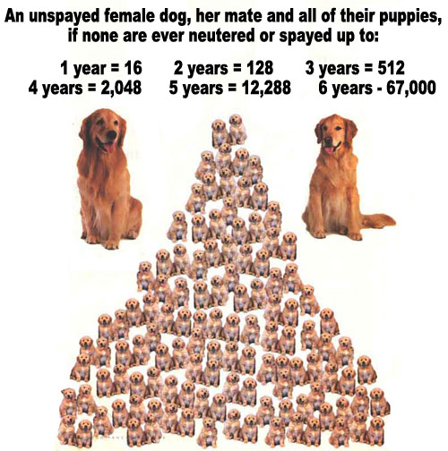
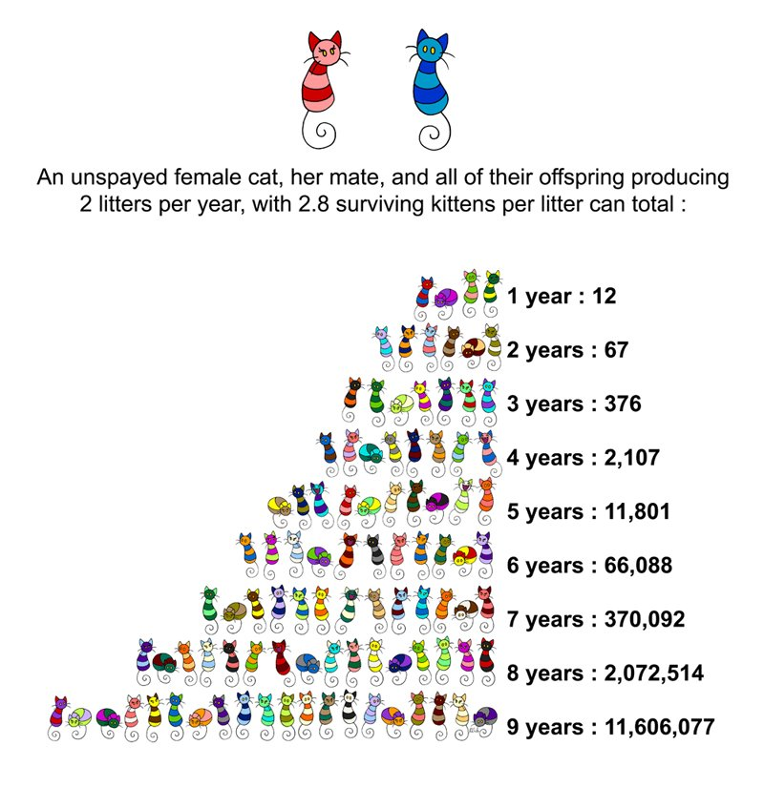
People do not spay or neuter their pets

Slide 6
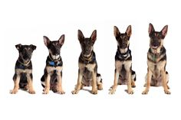
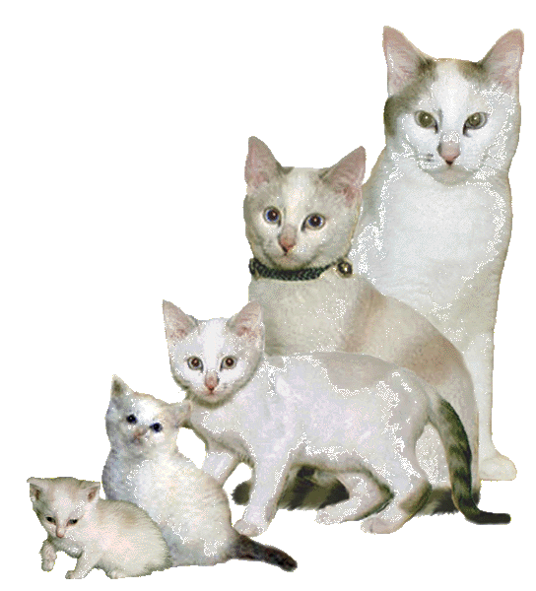
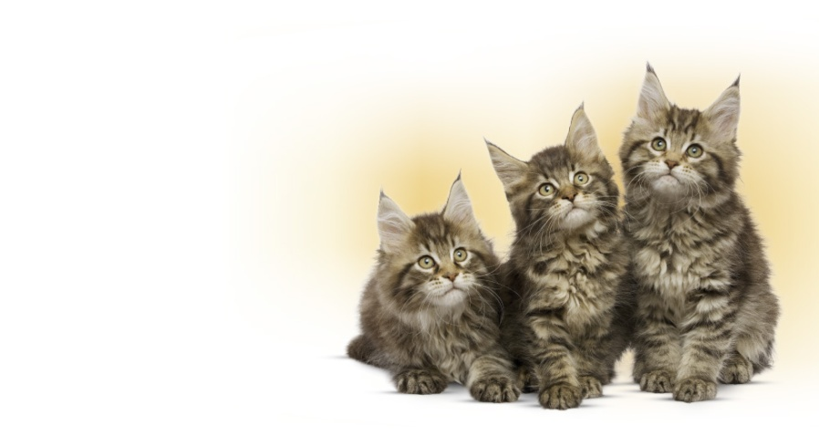
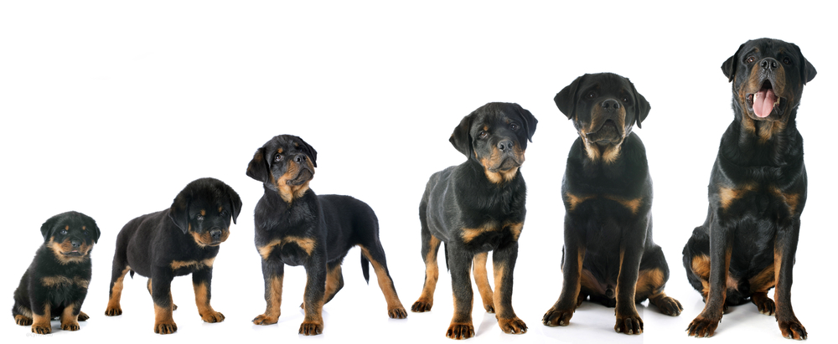
Cute little kitties
And
puppies grow up
And no longer wanted
They are dumped, let loose, given away, or taken to the shelter

Slide 7
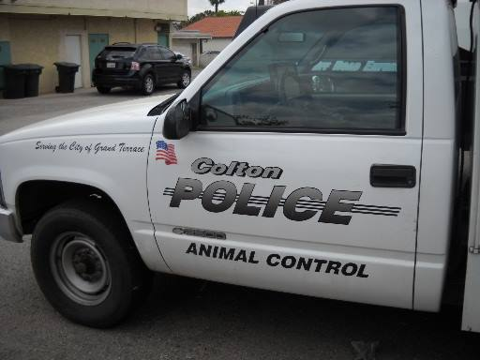
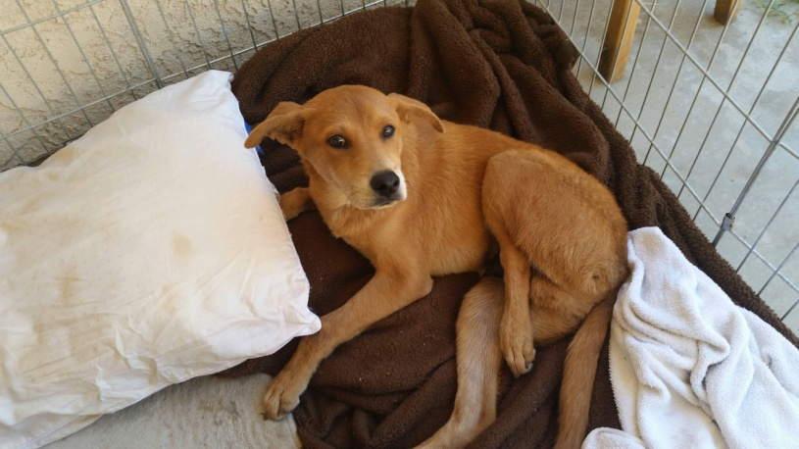
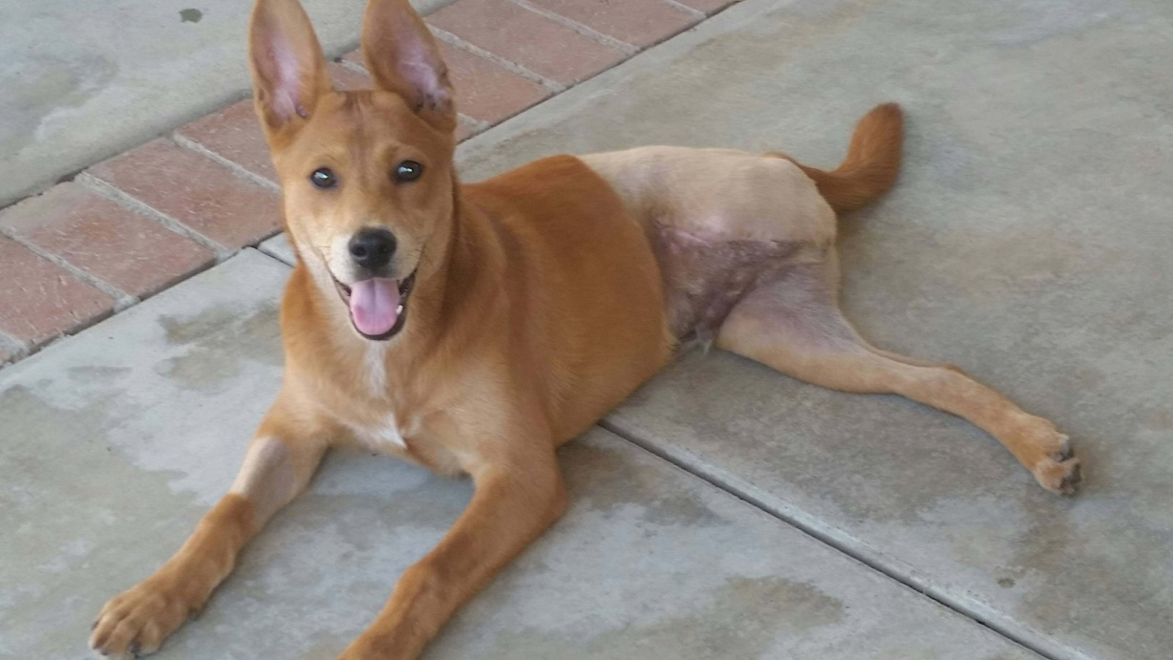
People allow dogs to run loose or unable to secure them at home or in the yard
These animals are picked up by animal services, hit by cars, and on rare occasion,
taken in to a new loving home off the street
This is FOX. Abandoned, Hit by a car, and rescued. Leg needed to be amputated. Now in a loving and happy home.

Slide 8
Pet Statistics
Approximately 7.6 million companion animals enter animal shelters nationwide every year. Of those, approximately 3.9 million are dogs and 3.4 million are cats.
Each year, approximately 2.7 million animals are euthanized (1.2 million dogs and 1.4 million cats).
Approximately 2.7 million shelter animals are adopted each year (1.4 million dogs and 1.3 million cats).
Of the dogs entering shelters, approximately 35% are adopted, 31% are euthanized and 26% of dogs who came in as strays are returned to their owner.
Of the cats entering shelters, approximately 37% are adopted, 41% are euthanized, and less than 5% of cats who came in as strays are returned to their owners.
Facts about Pet Ownership in the U.S.:
It's estimated that 70-80 million dogs and 74-96 million cats are owned in the United States. Approximately 37-47% of all households in the United States have a dog, and 30-37% have a cat. (Source: APPA)
The majority of pets are obtained from acquaintances and family members. 28% of dogs are purchased from breeders, and 29% of cats and dogs are adopted from shelters and rescues.
Facts about Pet Overpopulation in the U.S.:
It is impossible to determine how many stray dogs and cats live in the United States; estimates for cats alone range up to 70 million.
The average number of litters a fertile cat produces is one to two a year; the average number of kittens is four to six per litter.
The average number of litters a fertile dog produces is one a year; the average number of puppies is four to six.
Many strays are lost pets who were not kept properly indoors or provided with identification.
Only 10%of the animals received by shelters have been spayed or neutered

Slide 9
The Top 10 Reasons why people get rid of their pets
Dogs:
Moving (7%)
Landlord not allowing pet (6%)
Too many animals in household (4%)
Cost of pet maintenance (5%)
Owner having personal problems (4%)
Inadequate facilities (4%)
No homes available for litter mates (3%)
Having no time for pet (4%)
Pet illness(es) (4%)
Biting (3%)
Cats:
Moving (8%)
Landlord not allowing pet (6%)
Too many animals in household (11%)
Cost of pet maintenance (6%)
Owner having personal problems (4%)
Inadequate facilities (2%)
No homes available for litter mates (6%)
Allergies in family (8%)
House soiling (5%)
Incompatibility with other pets (2%)

Slide 10
David Toro foundation
Goals
Create new ordinances to address irresponsible pet ownership
Create programs to assist pet owners to be compliant and responsible
Remove the root cause of animals being loose on the street
Ensure that pets have a ticket home by microchip or license

Slide 11
David Toro foundation
Goals
The David Toro Foundation is a 501c3 Non-Profit Corporation and was created to raise funds to provide Free or Low Cost Spay and Neutering in the City of Colton, with the intent of growing beyond the Cities limits. The David Toro Foundation would also like to extend services to include free or low cost micro chipping, vaccinations, educational materials to promote responsible pet ownership, and funds to rescue animals out of the shelters.
Our Mission Statement and goal is to provide:
25 spay or neuter surgeries per month
25 microchips and registrations per month
25 vaccinations per month
5 rescues out of the shelter to adoption partners per month
Partnering with the Riverside County Department of Animal Services and the Loma Linda Animal Hospital to provide a discount cost for services, the David Toro Foundation will need to raise the following to achieve the goals that will promote responsible pet ownership, and give pets a chance for a longer, healthier, and happy life.
David Toro Foundation Success List | Month | Year
Spay or Neuter 25 @ $85 | $2,125.00 | $25,500.00
Microchip 25 @ $20 | $500.00 | $6,000.00
Vaccinations 25 @ $21 | $525.00 | $6,300.00
Rescue 5 dogs on STARTrescue .org transports@ $65 | $325.00 | $3,900.00
Total funds required | $3,475.00 | $41,700.00
The David Toro Foundation believes that pets are family and seeking partners that will allow us to provide the necessary services for pets in need and people that want to be responsible pet owners. Your monthly or one time donation can make this possible.
Thank You for supporting the David Toro Foundation and those animals that deserve a happy life.
Donations can be sent via:
Pay Pal to davidtorofoundation@davidtoro.com.
Send checks to David Toro Foundation. 1467 Teresa Ave. Colton, Ca. 92324
Credit Card Payment at www.davidtoro.com. Under David Toro Foundation donate button.
Tax ID – 47-4198675
David Toro – President
Email: davidtorofoundation@davidtoro.com
Cell – 909-996-7807

